Slide 1
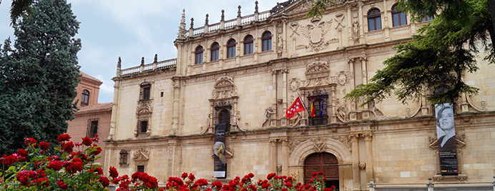
Welcome
to this rather unusual meeting…

Slide 2
Our aim over these two days
To create literacy units we are proud of and able to use in class straight away
The whole unit (min. 4 lessons) –> all steps in the planning grid
All materials including worksheets and power-point presentations
Locate relevant materials for download

Slide 3
What if we don’t finish?
You have until March 31st to finish everything (no later!)
On March 31st complete units and materials have to be sent to Artur
You get paid for this!

Slide 4
How are we going to organize this?
Connect via Skype with your groups (5 min.)
Get to know each other (5 min.)
Talk about the planning grids and choose the one you are going to develop (10 min.)
Examine the planning so far, clarify necessary aspects, distribute work and agree on time for the next connection (10 min.)

Slide 5
From then on
Time is yours!
Get organized as suits the group best!
Review each others’ work before moving on to the next stage.
Work through the unit plan step by step.
Ask for assistance whenever necessary:
brzosko-barratt
mateja.Dagarin
serrano_elena
candel-halbach

Slide 6
A few important issues
The work on text features and expressive features needs to be explicit
In the table on p. 1, try to be as specific as possible: “coherence and cohesion” are very general and don’t tell me what will be worked on; same with language functions or vocabulary
You don’t need to fill in all the lines in the table on the first page, only as relevant!

Slide 7
 |  | Teaching point | Level expected
Textual | Text features (organization of ideas; narrator; use of direct speech; paragraphing; etc.)
 | Text effect (creating tension; vividness of descriptions; objectivity; coherence; etc.)
Linguistic | Language functions / structures
 | Vocabulary
 | Pronunciation
 | Academic language features
Cultural
Strategic (learning and thinking strategies)
Cross-curricular links
Emotional skills
Development of values

Slide 8
A few important issues
Make sure that what is written in the table on p. 1 is actually worked on in the unit. It should appear in column 2 of the rest of the tables
Make sure that what you write in the 2nd column is really what the activity in column 1 focuses on
Remember that writing is a process, and we need to guide students through it
Try to keep your students in mind when planning

Slide 9
Next connection with everyone
14’30h

